Slide 1
Image classification using hierarchical based shifted
window Vision Transformers.
Naveen Raju Sreerama Raju Govinda Raju | A20516868
Raghunath Babu | A20511598
CS 577 Deep Learning
Professor - Yan Yan

Slide 2
Outline
Motivation and Problem Description
Data Set Description
Motivation to use this dataset
Sample images
Algorithms
Vision Transformer
Swin Transformer
Evaluation metrics
Conclusion and Future works
References

Slide 3
Problem Description

Slide 4
Scalability and efficient memory usage
Addressing the issue of effectively capturing long-range dependency in images
Adaptation to various image sizes
Hierarchical representation which aids learning of both local and global hierarchical features

Slide 5
Data Set Description

Slide 6
Dataset Description
Data set name : Food 101
Data set Source : ETH Zurich (https://data.vision.ee.ethz.ch/cvl/datasets_extra/food-101/)
Number of classes : 5
Classes considered : Garlic bread, Hot dog, Ice cream, Omelette, Pizza
Data set size : 1000 images per class
Train data : 960 images per class
Test data : 40 images per class

Slide 7
Motivation to use this dataset
Long-range dependencies : To learn long-range dependencies because the arrangement of ingredients or the overall structure of a dish may influence the classification
Fine-Grained Details : Food images often contain intricate details, textures, and patterns that are crucial for accurate classification. Capturing fine-grained information is essential for distinguishing between visually similar dishes.
Inter-Class and Intra-Class Variability : Food categories may exhibit both inter-class and intra-class variability. Different variations of the same dish and diverse presentations of different dishes pose challenges for classification.

Slide 8
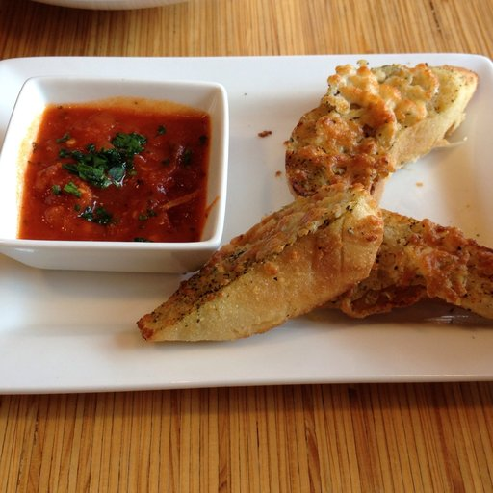
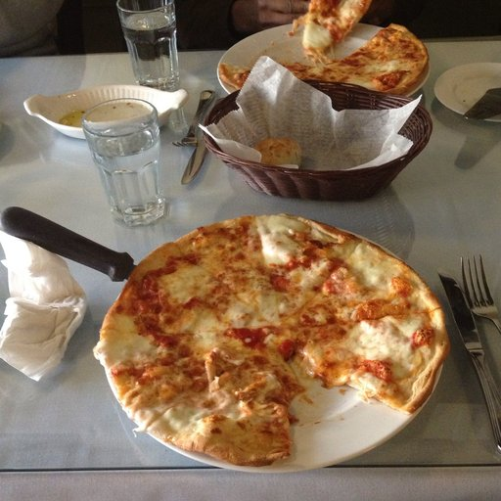
Sample images
Garlic bread Pizza

Slide 9
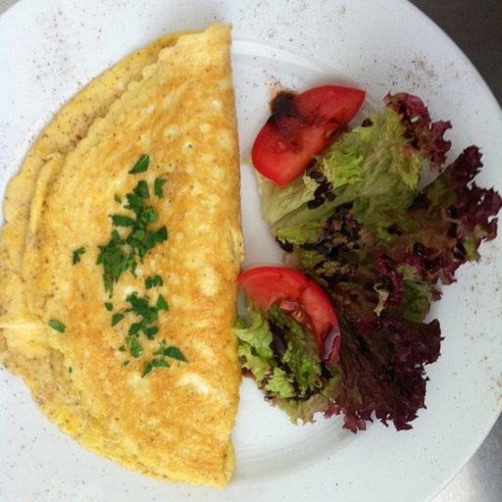
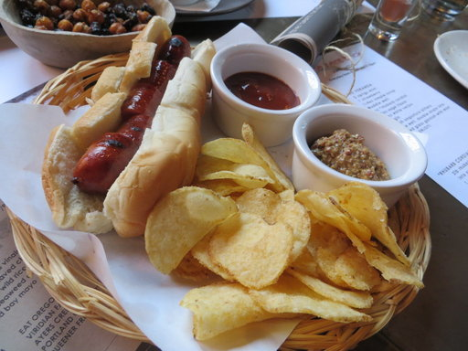
Omelette Hot dog

Slide 10
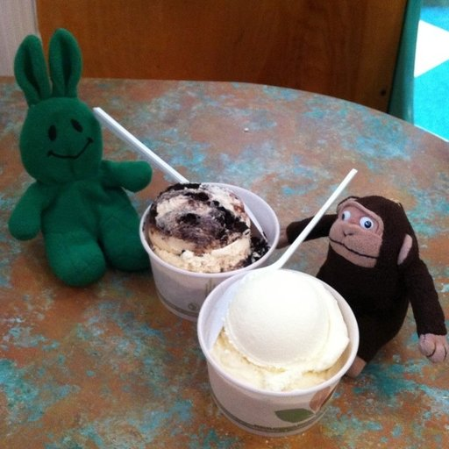
Ice cream

Slide 11
Algorithms

Slide 12
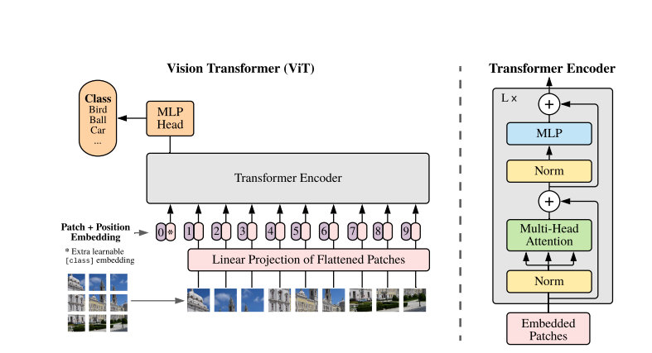
Vision Transformer( ViT)
Architecture

Slide 13
Vision Transformer (ViT)
Architecture and Hyper parameters details:
Input size : 224*224*3
Number of head : 12
Number of transformer layers = 12
Embedding dimension = 768 (16*16*3)
Multi layer perceptron size = 3072
mlp_dropout = 0.1, 0.2
attn_dropout = 0, 0.2
embedding_dropout = 0.1, 0.2
Patch size = 16
Optimiser: Adam, AdamW
Weight decay = 0.3, 0.001,0.03
Initial learning rate = 0.001,0.0001
Cosine Annealing learning rate : min=0.0001
Step learning rate
Label smoothening = 0.3
Normalize(mean=[0.556, 0.447, 0.335], std=[0.231, 0.242, 0.238])

Slide 14
AUGMENTATION:
Random Horizontal Flip
Random Vertical Flip
ColorJitter (brightness=0.2, contrast=0.15, saturation=0.1, hue=0.1)
Random Affine (degrees=0, translate=(0.1, 0.1), scale=(0.8, 1.2)
Random Perspective (distortion_scale=0.2, p=0.5)
Gaussian Blur (kernel =5)
Gaussian Noise

Slide 15
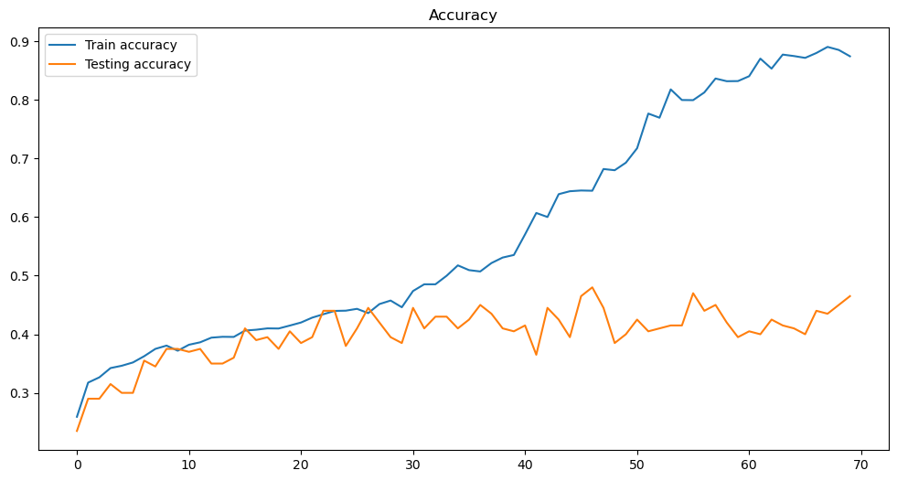
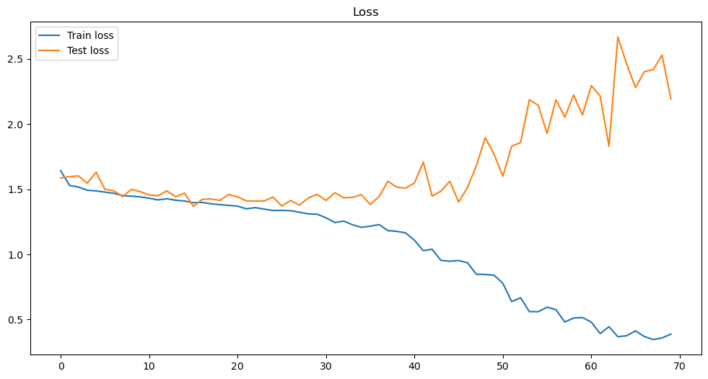
Training Graphs (Vision Transformer)
Train and test accuracy graph
Train and test loss graph

Slide 16
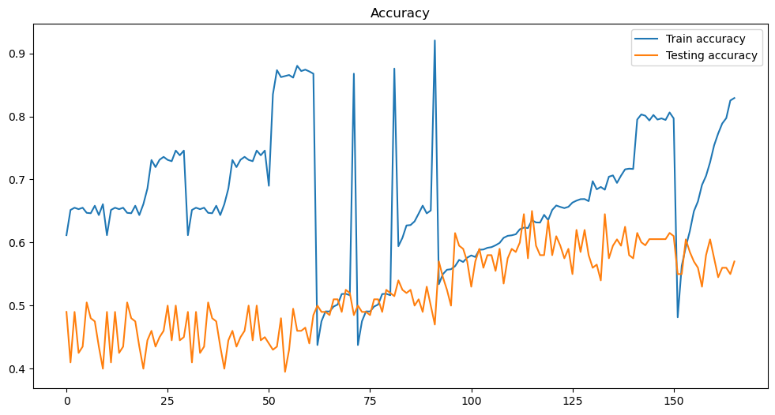
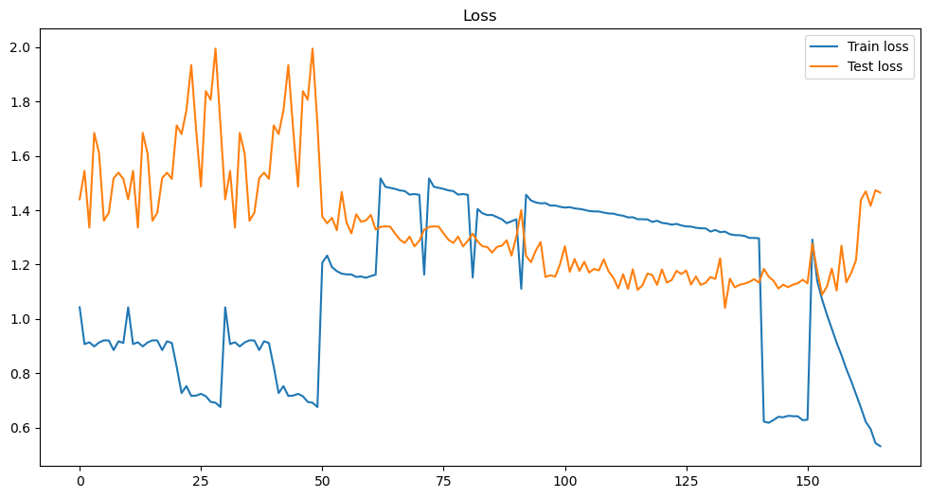
Train and test accuracy graph
Train and test loss graph

Slide 17
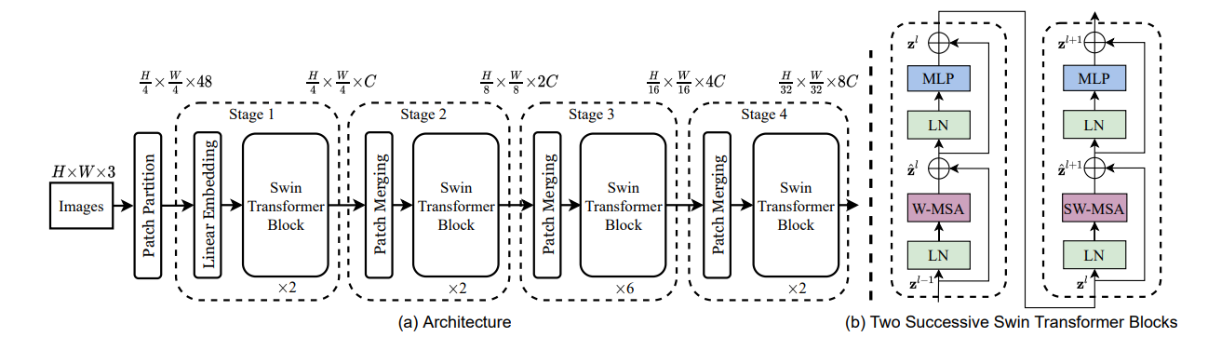
Swin Transformer
Architecture

Slide 18
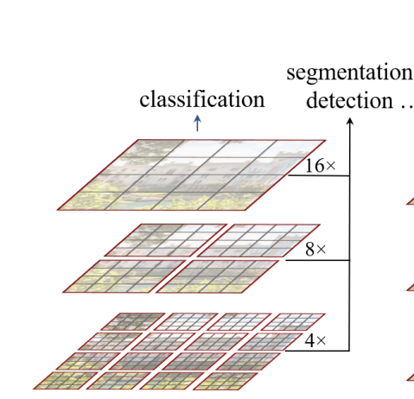
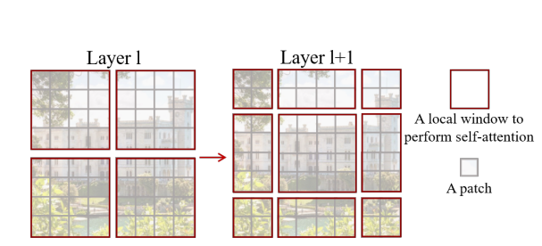
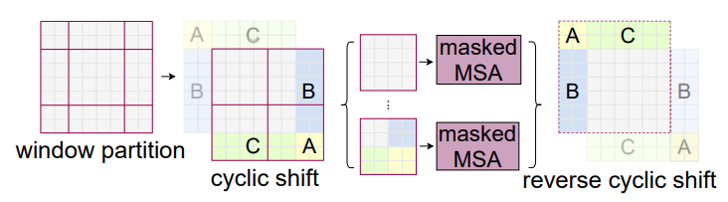

Slide 19
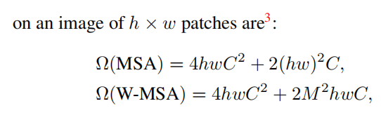
Swin transformers
Vision Transformer with hierarchical feature maps, Starts from small patches and merge neighbouring patches in deeper networks
Limiting self attention to non overlapping local windows(collection of patches), and achieving global context by cross window connection through a phenomenon - shifted window
Thus demonstrated the same potential of ViT by linear computation complexity instead of quadratic computation
Shifted window
Windows displaced by cyclic fashion
All query patches within a window share same key
Set (lower latency compared to sliding window)
M- window dimension

Slide 20
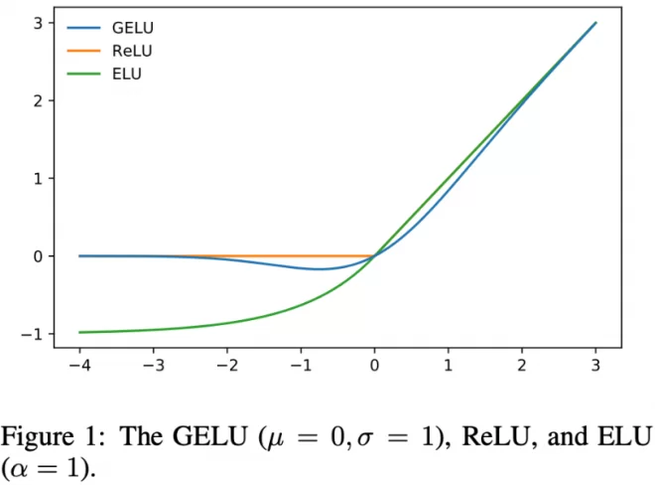
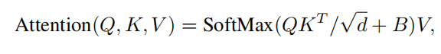
High level Architecture
Shifted window based MSA
2 layer MLP
(GELU non linear)
Linear norm.
(applied before MSA)
Positional embedding
1.Absolute positional embedding: provides info about exact position of tokens( drops performance)
2. Relative positional embedding: distance between takens(allows model to capture patterns and dependencies) - Implemented

Slide 21
2 .Swin Transformer (ViT)
Architecture and Hyper parameters details
Input size : 224*224*3
Number of Swin-Transformer blocks = 2
Embedding dimension = 96
Depths of each Swin-T transformer layer=[2,2,6,2]
No. of attention layer in each layer= [3,6,12,24]
mlp_dropout = 0
Patch size = 4*4
Optimizer: Adam
Initial learning rate = 0.0001,0.001
Weight decay = 0.0003, 0.01

Slide 22
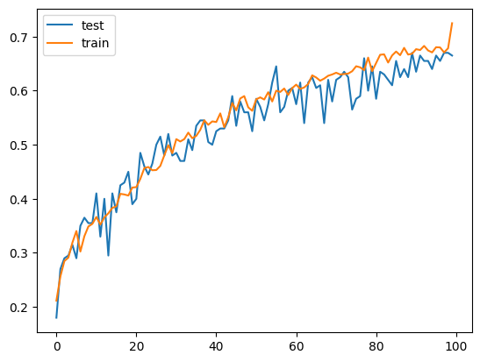
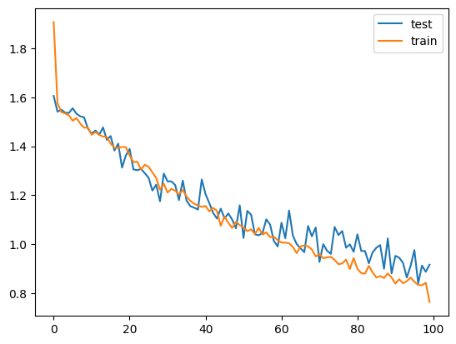
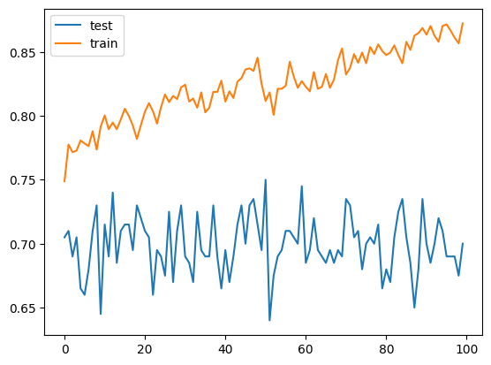
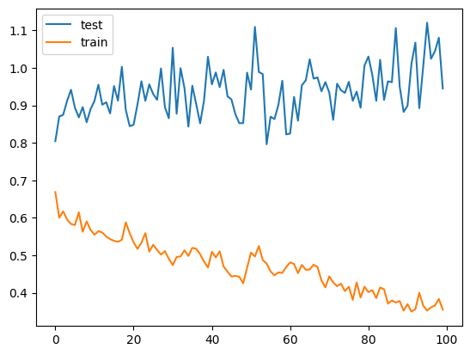
Training Graphs (Swin Transformer)
Train and test accuracy plot
Train and test loss plot

Slide 23
Evaluation Metrics

Slide 24
Vision Transformer Train data metrics:
Overall Accuracy: 80.66
 | Garlic Bread | Hot Dog | Ice cream | Omelette | Pizza
Precision | 78.63 | 76.8 | 79.65 | 80.54 | 88.22
Recall | 77.08 | 76.77 | 86.87 | 80.625 | 81.97
F1 Score | 77.85 | 76.81 | 83.10 | 80.58 | 84.98

Slide 25
Vision Transformer Test data metrics:
Overall Accuracy: 60.5
 | Garlic Bread | Hot Dog | Ice cream | Omelette | Pizza
Precision | 60.97 | 60.60 | 66.6 | 50 | 67.64
Recall | 62.5 | 50 | 70 | 62.5 | 57.5
F1 Score | 61.72 | 57.7 | 68.2 | 55.5 | 62.1

Slide 26
Swin transformer train data metrics
 | Garlic Bread | Hot Dog | Ice cream | Omelette | Pizza
Precision | 1 | 0.823 | 0.772 | 0.818 | 0.826
Recall | 0.8 | 0.7 | 0.85 | 0.9 | 0.95
F1 | 0.888 | 0.756 | 0.809 | 0.857 | 0.883
Overall Accuracy : 84 %

Slide 27
Swin transformer test data metrics
 | Garlic Bread | Hot Dog | Ice Cream | Omelette | Pizza
Precision | 0.703 | 0.687 | 0.866 | 0.733 | 0.740
Recall | 0.95 | 0.55 | 0.65 | 0.55 | 1
F1 | 0.808 | 0.611 | 0.742 | 0.628 | 0.851
Overall Accuracy : 74%

Slide 28
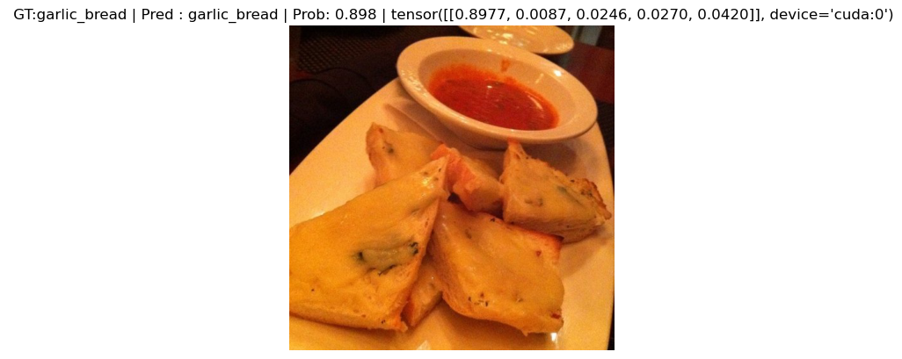
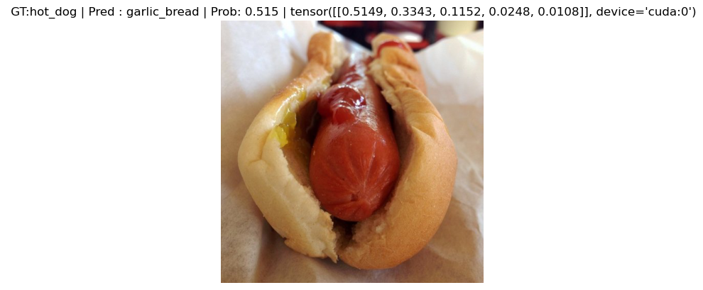
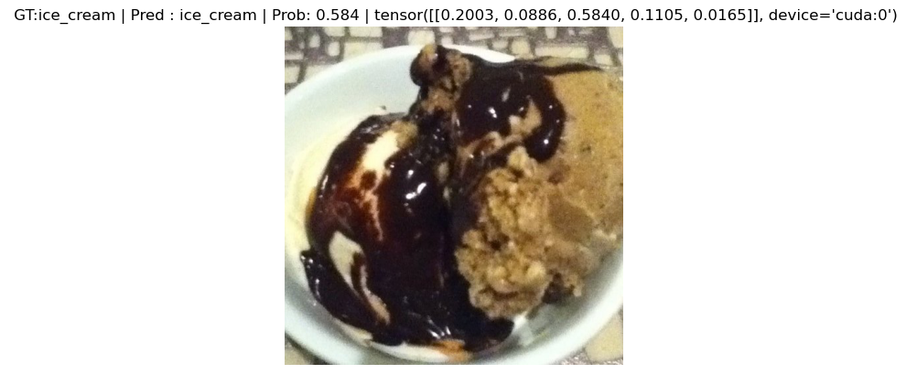
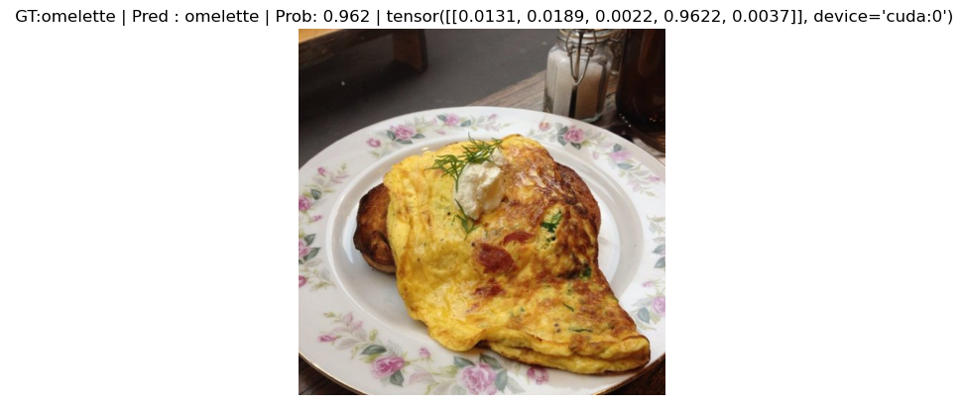
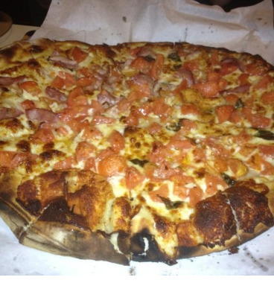
Correct Predictions
Ground Truth : Garlic Bread Ground Truth : Hot Dog Ground Truth : Ice cream Ground Truth : Omelette
Prediction : Garlic Bread Prediction : Hot Dog Prediction : Ice cream Prediction : Omelette
Ground Truth : Pizza
Prediction : Pizza

Slide 29
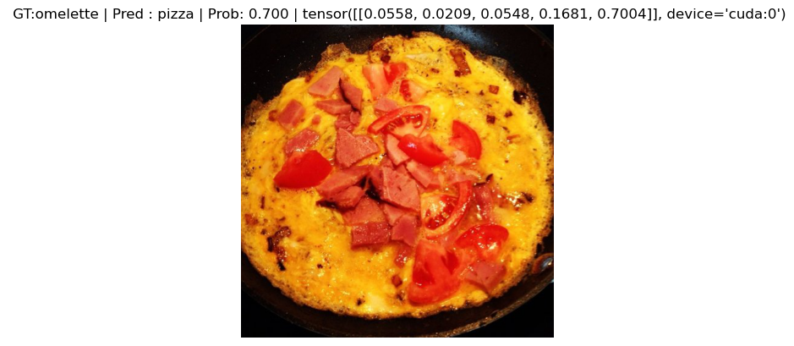
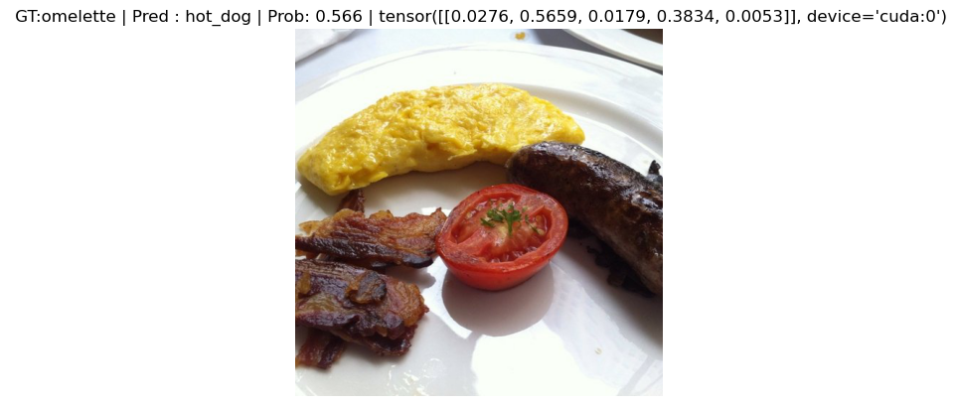
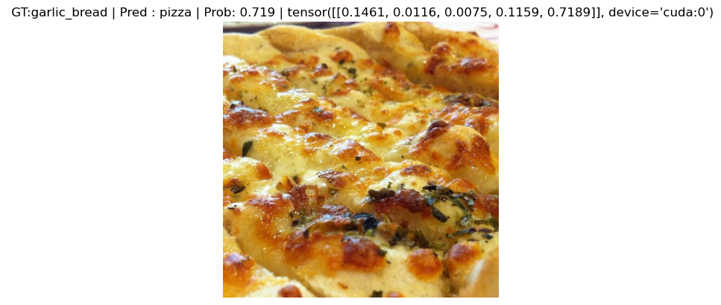
Wrong Prediction
Ground truth : Omelette Ground truth : Omelette Ground truth : Garlic Bread
Prediction : Pizza Prediction : Hot Dog Prediction : Pizza
Prediction:Pizza

Slide 30
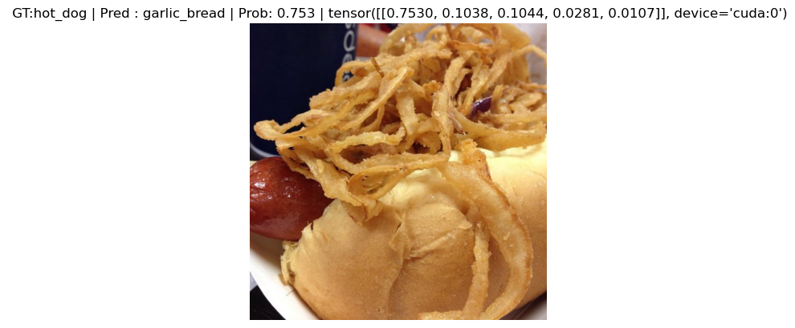
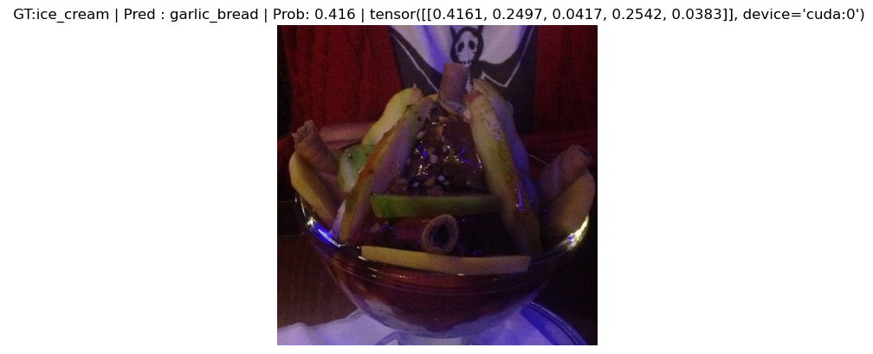
Ground truth : Hot Dog Ground truth : Ice cream
Prediction : Garlic Bread Prediction : Garlic Bread

Slide 31
Conclusion and Future works

Slide 32
Model Parameters Comparison
Vision Transformer(ViT)
Total params: 85,802,501
Trainable params: 85,802,501
Non-trainable params: 0
Swin transformer
Total params: 27,499,877
Trainable params: 27,499,877
Non-trainable params: 0
Therefore, it is clearly evident that the Swin Transformer, with just 30% of the total parameters compared to ViT, was able to outperform efficiently.

Slide 33
Swin Transformers achieves better performance preserving computational and memory footprint
Accommodate architectures like UNET, FPN - for Classification, Segmentation and Detection problem
Handle high resolution images with hireracheal features
Promising ideal results of Swin Transformers observed through training progress.
Explore the feasibility of Attention architectures and Relative Positional encoding for other tasks

Slide 34
References

Slide 35
1. D. Kang, P. Koniusz, M. Cho and N. Murray, "Distilling Self-Supervised Vision Transformers for Weakly-Supervised Few-Shot Classification & Segmentation," in 2023 IEEE/CVF Conference on Computer Vision and Pattern Recognition (CVPR), Vancouver, BC, Canada, 2023 pp. 19627-19638.
2. Agilandeeswari, L., Meena, S.D. SWIN transformer based contrastive self-supervised
learning for animal detection and classification. Multimed Tools Appl 82, 10445–10470
(2023).
3. Z. Liu, et al., "Swin Transformer: Hierarchical Vision Transformer using Shifted Windows," in
2021 IEEE/CVF International Conference on Computer Vision (ICCV), Montreal, QC,
Canada, 2021 pp. 9992-10002.
doi: 10.1109/ICCV48922.2021.00986
4. Alexander Kolesnikov and Alexey Dosovitskiy and Dirk Weissenborn and Georg Heigold and Jakob Uszkoreit and Lucas Beyer and Matthias Minderer and Mostafa Dehghani and Neil Houlsby and Sylvain Gelly and Thomas Unterthiner and Xiaohua Zhai.,” An Image is Worth 16x16 Words: Transformers for Image Recognition at Scale”,
5.https://github.com/huggingface/transformers/tree/v4.35.2/src/transformers/models/vit

Slide 36
Thank you

